Slide 1


IMPLEMENTATION OF POLAR CODES IN BATTERY CONSTRAINED DEVICES USING FNN
ABDUL WASAY NAVEED SUDAIS WASEEM ZAHID GUL WAJAHAT KHAN
Supervisor: Engr. Furqan Haider Qureshi
CO-Supervisor: Ma’am Sobia Hayee
Department of Electrical Engineering - 43

Slide 2
INTRODUCTION
Polar Codes: A class of capacity-achieving error-correcting codes for binary-input discrete memoryless channels (B-DMCs).
Introduced by Erdal Arikan in 2009.
They leverage channel polarization to achieve optimal data transmission.
Motivation: The growing demand for fast, efficient, and low-power decoding methods in wireless communication.
Applications: 5G systems, low-latency communication, IoT devices.

Slide 3
OBJECTIVES
Design and simulate a communication system based on polar codes and channel noise modeling.
Implement a Feedforward Neural Network (FNN) that intelligently selects among SC, SCL, and LVA decoders.
Use Bhattacharyya parameters to identify frozen bits and construct the polar code structure.
Incorporate wireless transmission features (e.g., retries, packet loss, CRC errors) into the FNN for decision-making.
Optimize decoding power consumption for embedded systems like ESP32 + LoRa using adaptive decoder prediction.
Compare predicted decoder results with traditional decoders (SC, SCL, LVA) in terms of BER, outage, and energy usage.

Slide 4
LITERATURE REVIEW
Polar Codes (Arıkan, 2009) are capacity-achieving codes adopted in 5G for their efficiency and performance.
SC, SCL, and LVA decoding (Tal & Vardy, 2011; Balatsoukas-Stimming et al., 2015) offer a trade-off between complexity, power, and error performance.
Embedded systems have limited power, making high-complexity decoding less feasible (Sarkar et al., 2019).
Neural networks are being applied in physical layer tasks like decoding and modulation (Ye et al., 2018).
FNN-based decoder selection enables adaptive, energy-aware communication (Kim et al., 2020).

Slide 5
SUSTAINABLE DEVELOPMENT GOALS
SDG-7 (Affordable and Clean Energy): Optimizing battery usage in constrained devices directly contributes to more sustainable and energy-efficient communication.
SDG-11 (Sustainable Cities and Communities): Enabling reliable and energy-efficient wireless communication is crucial for the development and operation of smart grids, environmental monitoring systems, and intelligent transport systems within sustainable cities.
SDG-9 (Industry, Innovation and Infrastructure): Enhancing error correction efficiency improves data reliability and reduces transmission power needs, supporting technological advancements in wireless infrastructure.

Slide 6
BLOCK DIAGRAM
TRANSMISSION OVER NOISY CHANNEL
OUTPUT
INPUT
ENCODER
FNN
DECODER
INFORMATION BITS
1.AWGN
2.Rayleigh Fading
3. Free Space
1.FEATURE EXTRACTION
2.DECIDING DECODER
DECODING TECHNIQUES
FROZEN
BITS
1.SC
2.SCL
3.LVD
CHANNEL
POLARIZATION

Slide 7
METHODOLOGY
Encoded and BPSK-modulated message signals.
Added AWGN and Rayleigh fading for channel simulation.
Implemented SC, SCL, and LV decoders in python.
Evaluated each decoder: BER, outage probability, power Consumption, PDP.
Trained FNN using 4 features: retries, ACK success rate, CRC, packet loss.
FNN predicts best decoder.
Tested on multiple signals and SNRs for performance comparison.

Slide 8
POLAR ENCODING
Polar Encoding: Uses a generator matrix constructed from repeated Kronecker products of a base kernel matrix (typically [[1, 0], [1, 1]]). This transforms a message vector into a longer encoded vector for error protection.
Frozen Bits: Polar coding divides the bit positions into 'reliable' and 'unreliable' using a measure of reliability.
Bhattacharyya Parameter: A mathematical metric used to estimate the reliability of each bit channel. Lower values mean higher reliability.
Process:
Compute Bhattacharyya parameters based on the design SNR.
Sort the parameters to identify the most reliable K bit positions.
Set the remaining (N−K) positions as frozen (usually fixed to 0).
Result: Only the K most reliable positions carry actual information; frozen bits guide decoding and reduce ambiguity, improving performance over noisy channels.

Slide 9
CHANNEL MODEL
Rayleigh Fading: Models signal reflections from multiple paths causing interference. Common in wireless and mobile scenarios.
AWGN (Additive White Gaussian Noise): Simulates thermal noise with zero mean, affecting amplitude and phase.
Combined Model: Realistic simulation combining fading and noise to evaluate decoder performance.
Mathematical Model: y=hx+N
h: Channel gain (Rayleigh-distributed)
x: Transmitted signal
N: Gaussian noise
Observation from Plot:
AWGN channel leads to steep BER reduction with increasing SNR.
Rayleigh channel exhibits slower BER improvement due to multipath fading.

Slide 10
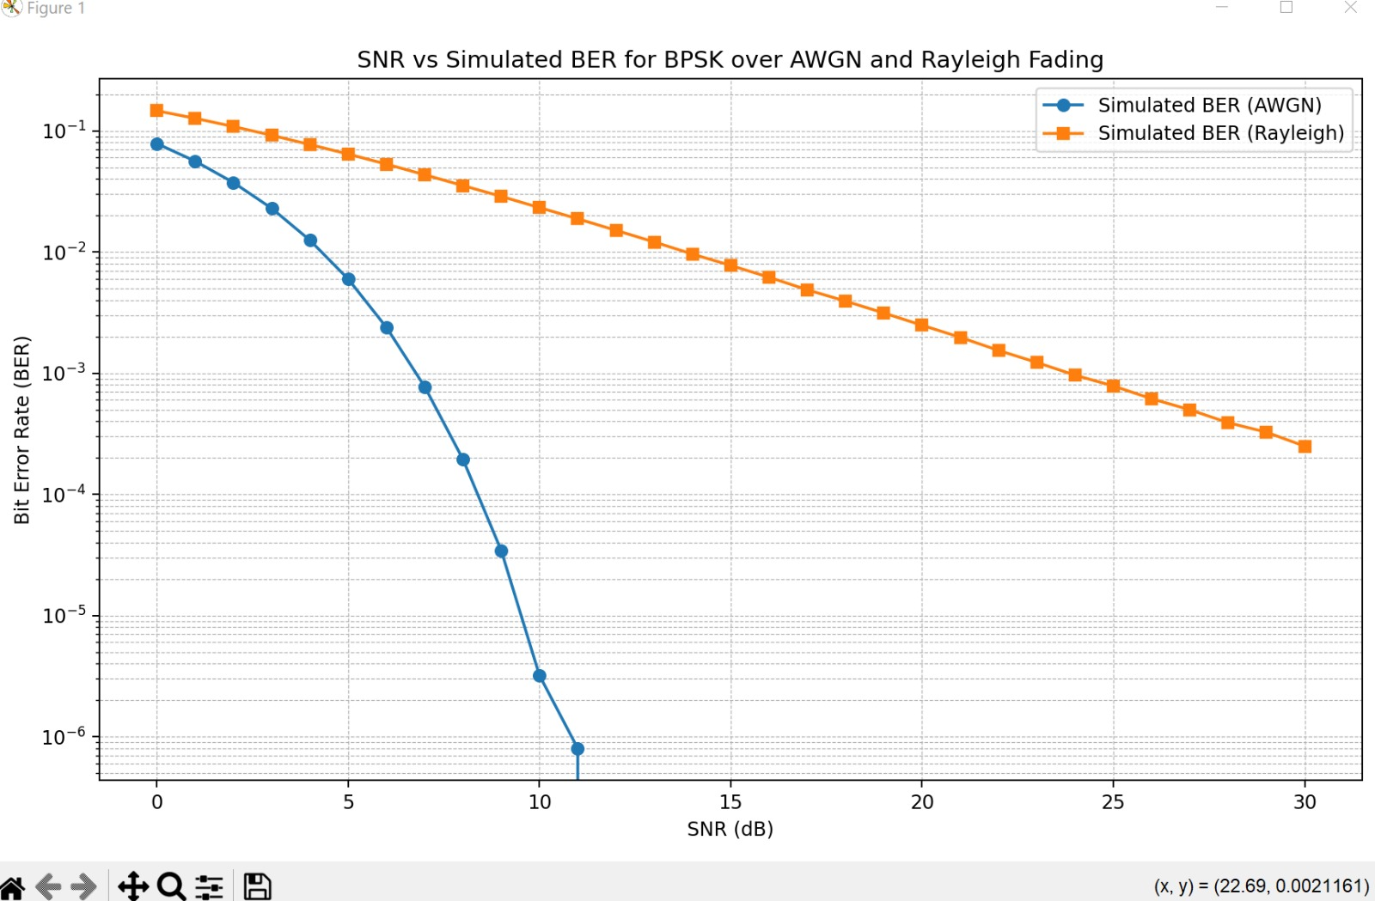
CHANNEL MODEL

Slide 11
NEURAL NETWORK DESIGN
Model Overview: A Feedforward Neural Network (FNN) is used to classify and select the most appropriate decoder for a received signal under noisy conditions.
Purpose: Instead of hardcoding decoder logic, we let the FNN learn patterns in signal behavior and environmental features to choose SC, SCL, or LVA.
Input Features:
Retries: Indicates retransmission attempts due to failed acknowledgments.
Packet Loss Rate: Measures overall link quality.
ACK Success Rate: High rates suggest reliable communication.
CRC Error Rate: Detects error presence in packets.
Feature Scaling: Each feature is normalized using fixed mean and standard deviation to ensure balanced input magnitudes during training.

Slide 12
NEURAL NETWORK DESIGN
FNN Architecture Details:
Input Layer: 4 input neurons, corresponding to scaled transmission feature inputs.
Hidden Layers:
Two or more fully connected (dense) layers
ReLU activation for non-linearity
Output Layer:
3 neurons, each corresponding to a decoder class: SC, SCL, LVA
Softmax activation to output normalized class probabilities
Loss Function: Categorical cross-entropy, ideal for multi-class classification.
Optimizer: Adam optimizer for fast convergence and efficient training.
This design enables the network to make quick, accurate decisions suitable for embedded systems with limited resources.
Architecture:
Input Layer: 4 neurons (scaled features)
Hidden Layers: Dense layers with ReLU activation and dropout regularization
Output Layer: 3 neurons with softmax activation (for SC, SCL, LVA decoder probabilities)

Slide 13
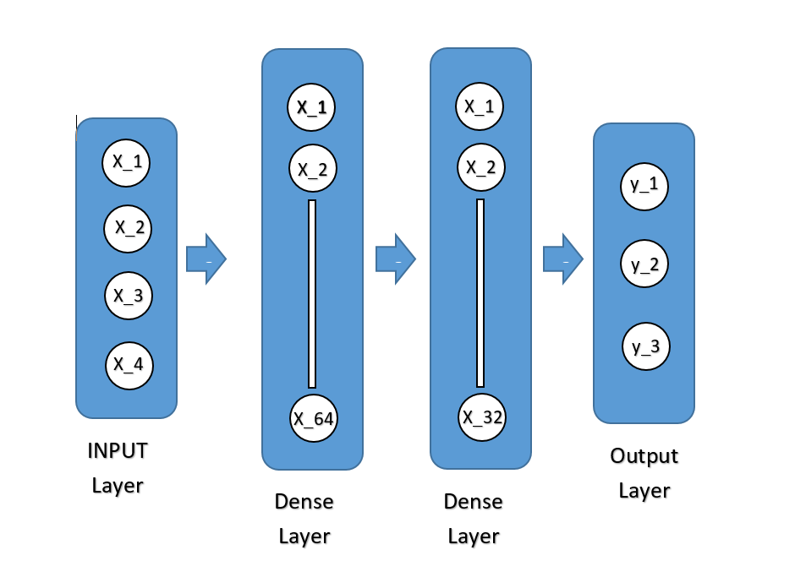
NEURAL NETWORK DESIGN
4 FEATURES:
Retries
Packet Loss Rate
ACK Success Rate
CRC Error Rate
OUTPUT:
SC
SCL
LV

Slide 14
DECODER SELECTION USING FNN
Classification Objective: Once input features are passed through the FNN, the output is a probability distribution across three classes: SC, SCL, and LVA.
Softmax Output Interpretation:
The decoder with the highest probability is selected.
For example, [0.7, 0.2, 0.1] → SC selected.
Fallback Logic:
In scenarios with high uncertainty or borderline probabilities, rule-based logic refines the decision.
Example: At low SNR, if predicted decoder is LVA but retries and CRC error are low, switch to SC to save power.
Energy-Aware Strategy:
Model is designed not only to minimize BER but also to optimize for power efficiency.
Decoder selection adapts to environment dynamically—more robust decoders like LVA are used only when needed.
Outcome:
Reduces unnecessary decoder complexity.
Ensures reliable communication while conserving energy—ideal for battery-powered embedded systems.

Slide 15
TRAINING & MODEL LOADING
Data Preparation:
Training data generated from simulated transmission scenarios under Rayleigh + AWGN channel conditions.
Each sample includes scaled features (retries, packet loss, ACK success, CRC error) and corresponding optimal decoder label.
Feature Standardization:
Each input feature is normalized using fixed mean and standard deviation to ensure consistent training behavior.
Model Training:
The FNN is trained using the Adam optimizer with categorical cross-entropy loss.
Training involves multiple epochs with dropout applied to prevent overfitting.

Slide 16
SOFTWARE & SIMULATION STACK
Programming Language: Python was chosen for its robust support in
scientific computing and machine learning.
Libraries and Tools:
TensorFlow: Used for building, training, and loading the FNN model.
NumPy: For efficient numerical computations including matrix operations
for polar encoding.
Pandas: Used to efficiently organize, preprocess, and analyze datasets for training the FNN and evaluating decoder performance.
Matplotlib: Used to visualize results such as BER curves, power consumption
and outage plots.
Simulation Environment:
Includes realistic channel modeling (Rayleigh fading + AWGN),
polar encoding, and decoding using SC, SCL, and LVA.
The simulation mimics real-world conditions for SNR ranging from 0 to 30 dB.

Slide 17
SIMULATION PARAMETERS
Codeword Length (N): 2048 bits – the full length of each encoded message, ensuring high redundancy.
Information Bits (K): 1024 bits – the actual payload carrying useful data.
SNR Range: 0 to 30 dB in steps of 1 dB – used to evaluate system behavior across varying noise conditions.
Trials per SNR Level: 1000 – ensures statistical reliability and sufficient sampling to evaluate average BER and outage.
Power Modeling:
Based on a practical setup using ESP32 microcontroller with LoRa wireless module.
Takes into account instruction execution energy (nJ per instruction) and LoRa receive power.
SNR-dependent power scaling adds realism by increasing power consumption under low SNR.

Slide 18
DECODER IMPLIMENTATION
SC (Successive Cancellation) Decoder
Principle: Decodes bits one-by-one in a sequential fashion using log-likelihood ratios (LLRs).
Advantage: Low complexity and fast execution.
Limitation: Performance suffers at low SNR because errors propagate through the sequential process.
Use Case: Suitable for clean channels or energy-constrained scenarios.

Slide 19
DECODER IMPLIMENTATION
SCL (Successive Cancellation List) Decoder
Principle: Maintains multiple decoding paths (list size L) to improve decision-making.
Advantage: Offers significantly better BER than SC, especially when combined with CRC checks.
Limitation: Increased complexity and memory usage.
Use Case: Mid-SNR environments where performance is more critical than power.

Slide 20
DECODER IMPLIMENTATION
LV (List Viterbi) Decoder
Principle: An enhanced version of list decoding using Viterbi’s traceback for path selection.
Special Feature: Integrates Kronecker-based structure of polar codes.
Advantage: Best decoding performance among the three.
Limitation: Highest computational cost.
Use Case: High-SNR or performance-critical situations.

Slide 21
ADAPTIVE DECODER SELECTION
SC (Successive Cancellation): A sequential and low-complexity decoder. It consumes the least power and is ideal for stable channel conditions. Selected when retries are low and packet loss is minimal.
SCL (Successive Cancellation List): Offers better decoding accuracy by tracking multiple decoding paths. It has moderate complexity and is used when the channel shows increasing error rates.
LVA (List Viterbi Algorithm): The most robust and accurate decoder, but also the most power-consuming. It is chosen only in severely noisy environments where other decoders would likely fail.
FNN predicts the most suitable decoder class using softmax output based on live transmission features. Dynamic thresholds then refine this choice to enhance energy efficiency.

Slide 22
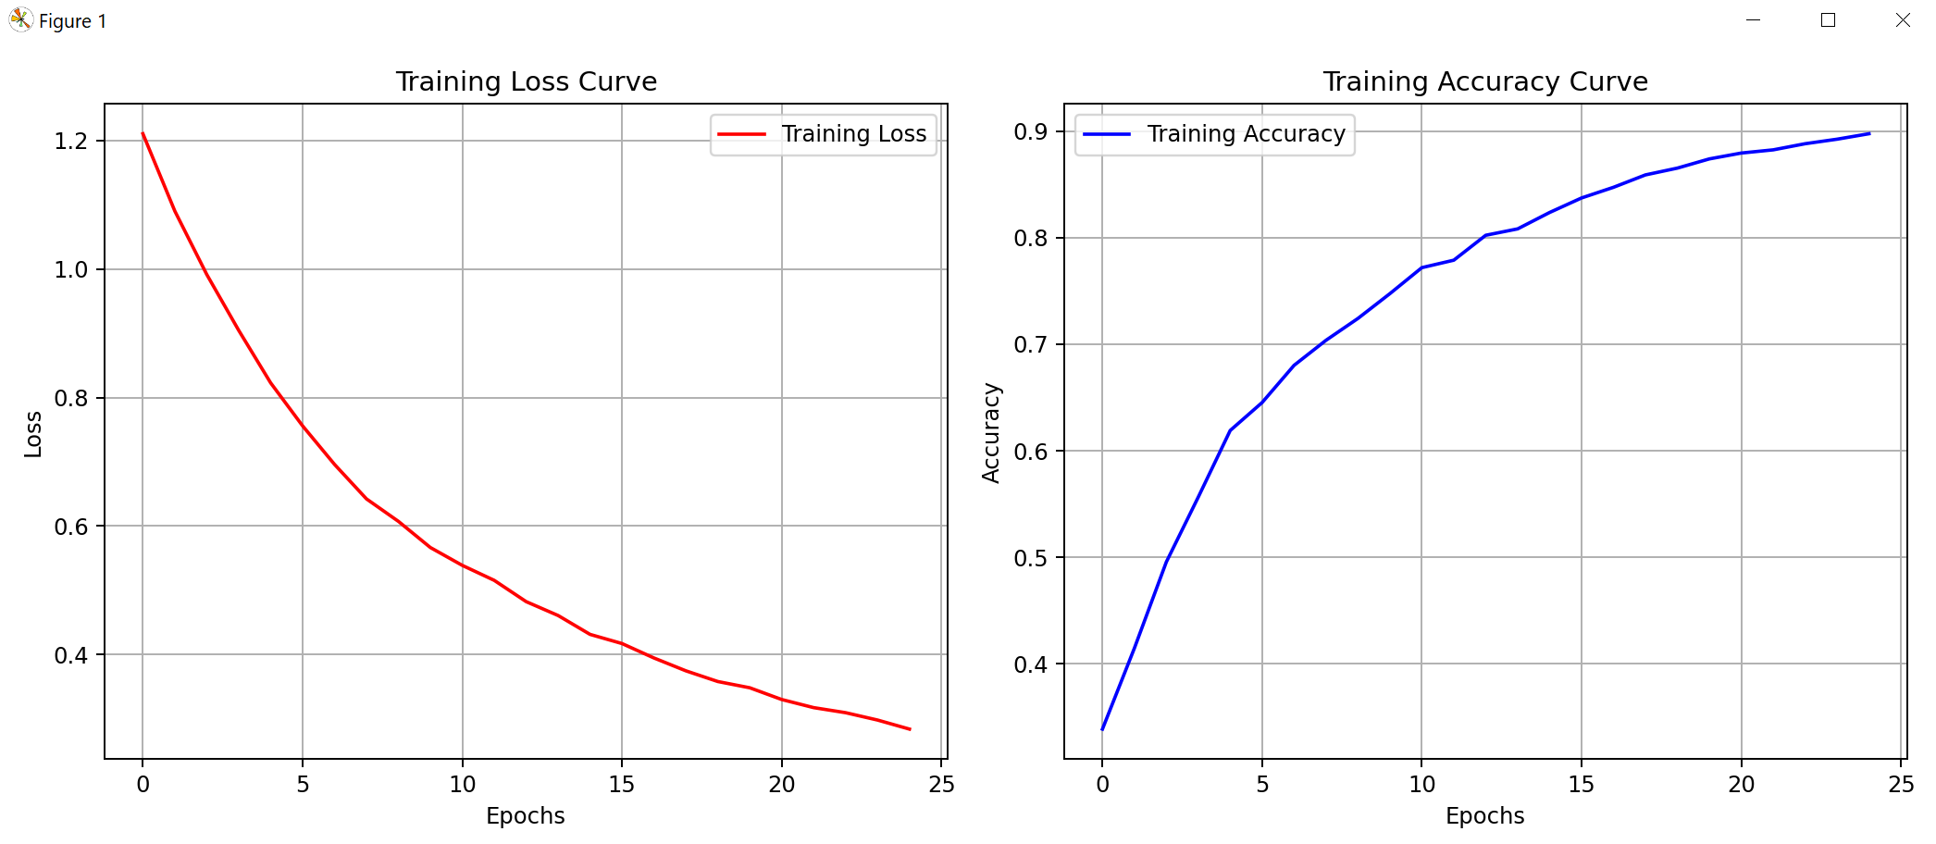
TRAINING GRAPH
Class | Precision | Recall | F1-score
LV | 0.97 | 0.97 | 0.97
SC | 0.83 | 0.94 | 0.88
SCL | 0.80 | 0.77 | 0.78
Training Accuracy: 88%

Slide 23
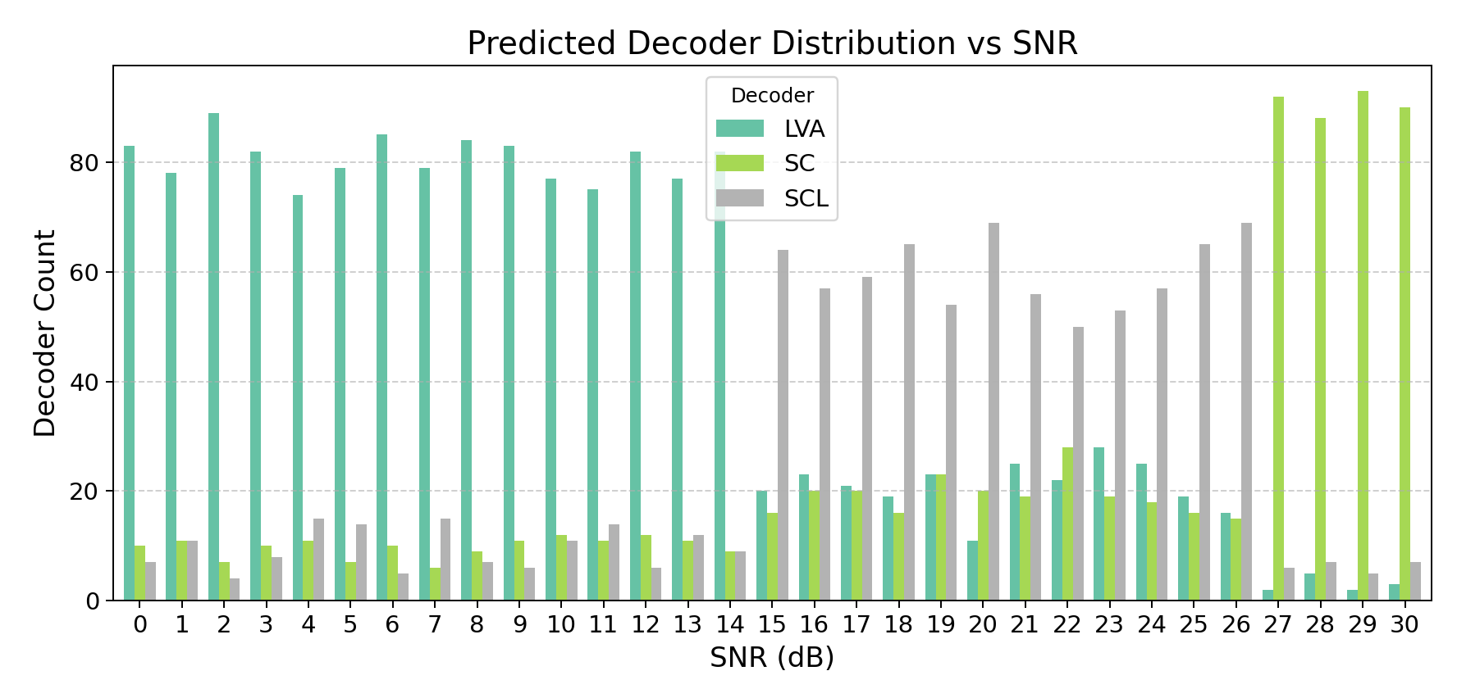
DECODER SELECTION GRAPH
Class | Precision | Recall | F1-score
LV | 0.90 | 0.90 | 0.90
SC | 0.91 | 1.00 | 0.95
SCL | 0.91 | 1.00 | 0.95
Testing Accuracy: 93%

Slide 24
EVALUATION METRICS
BER (Bit Error Rate):
Measures the fraction of bits received incorrectly.
Lower BER indicates better decoding performance.
Tracked across SNR levels to compare decoder accuracy.
Outage Probability:
Probability that BER exceeds a threshold (e.g., > 10⁻³).
Used to assess reliability—critical in safety or mission-critical applications.
Average Power Consumption (mW):
Total energy used by decoding operations across SNRs.
Includes MCU computation + LoRa receive power.
Crucial for evaluating suitability on low-power devices.

Slide 25
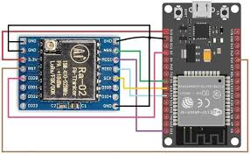

HARDWARE
ESP32:
Dual-core, up to 240 MHz
Wi-Fi + Bluetooth (BLE)
520 KB RAM, 4MB Flash
34 GPIOs (ADC, DAC, UART, SPI, etc.)
Voltage: 3.3 V
Power: ~160 µA (sleep), ~240 mA (Wi-Fi)
LoRa SX1278:
Dual-core, up to 240 MHz
Wi-Fi + Bluetooth (BLE)
520 KB RAM, 4MB Flash
34 GPIOs (ADC, DAC, UART, SPI, etc.)
Voltage: 3.3 V
Power: ~160 µA (sleep), ~240 mA (Wi-Fi)
Decoder | Instructions | Power (mW)
SC | ~10,000 | ~0.37
SCL | ~50,000 | ~0.41
LVA | ~100,000 | ~0.46
$$P_{total​}=P_{radio}​+P_{compute}​$$

Slide 26
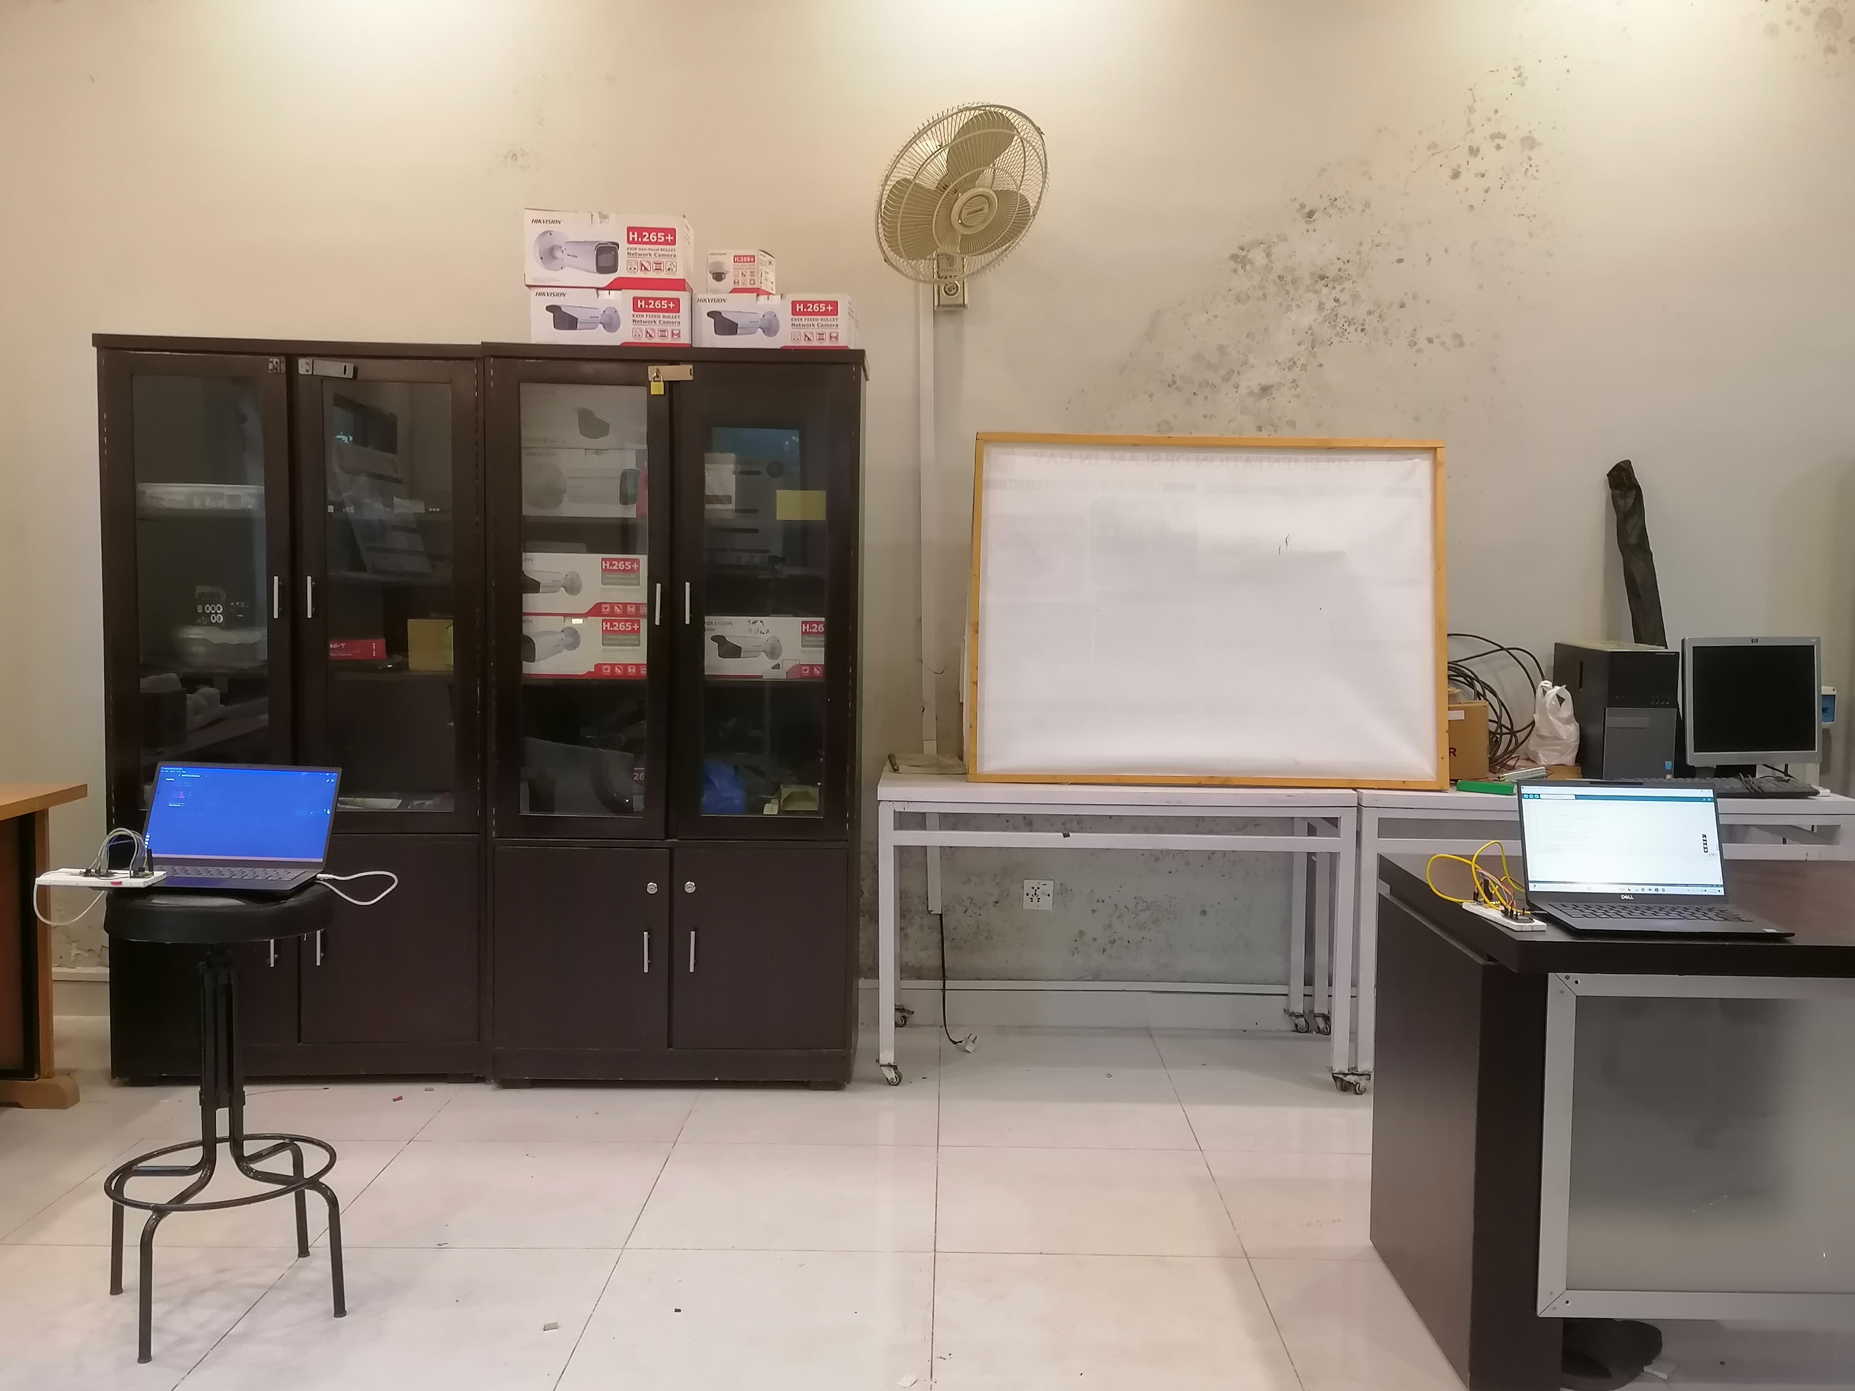
SETUP
Y = hx + N
TRANSMITTER
RECIEVER

Slide 27
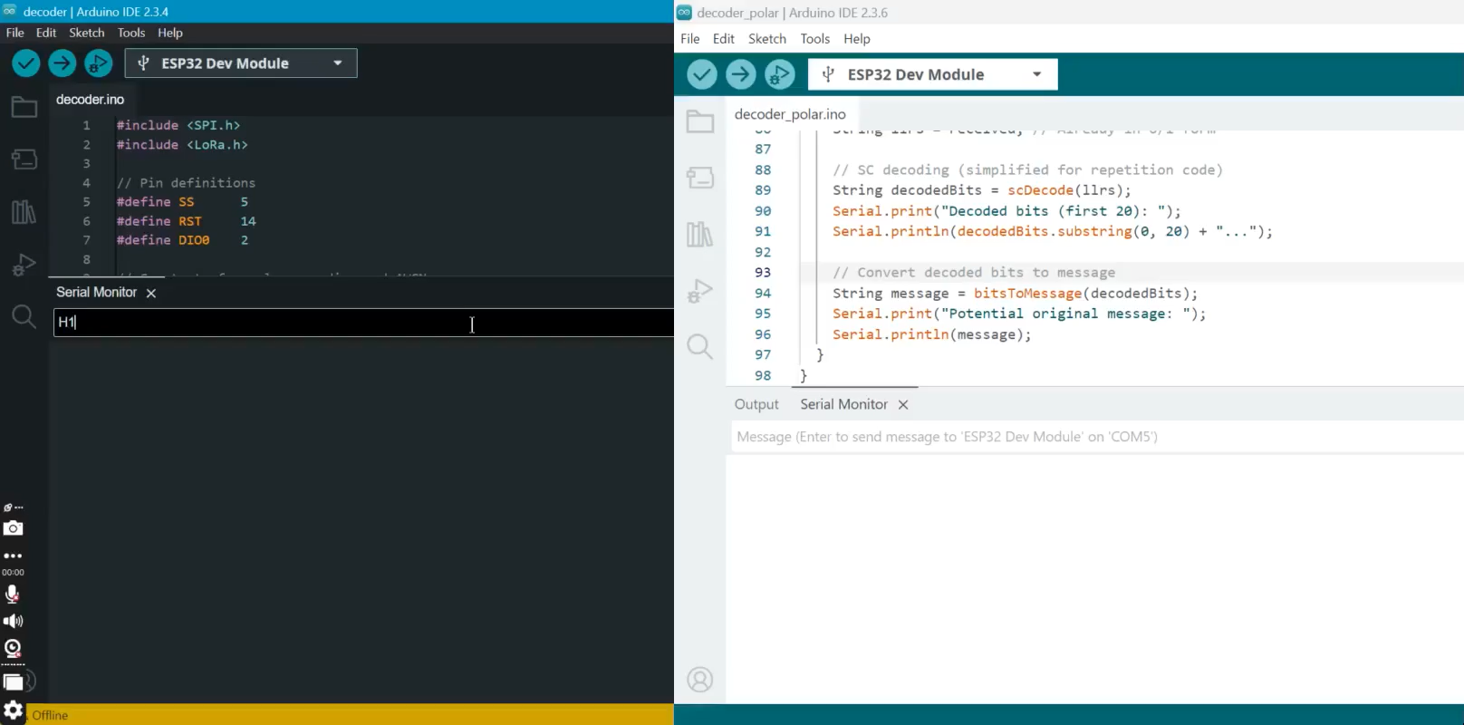
SIMULATION

Slide 28
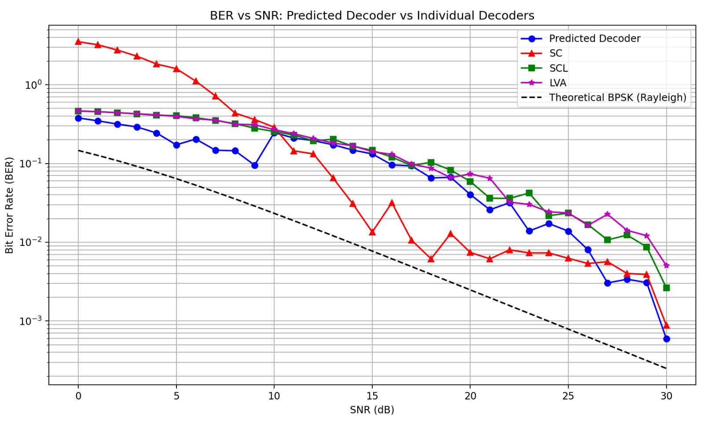
BER vs. SNR (Predicted vs Traditional)

Slide 29
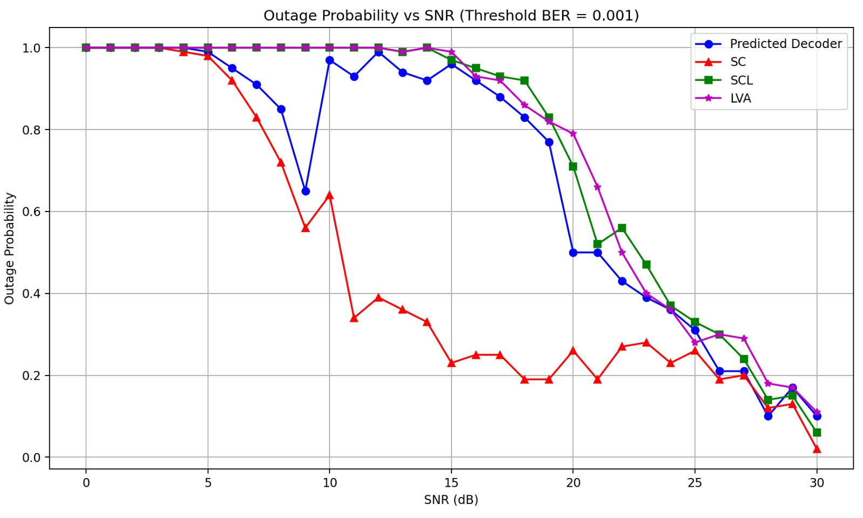
Outage Probability vs. SNR

Slide 30
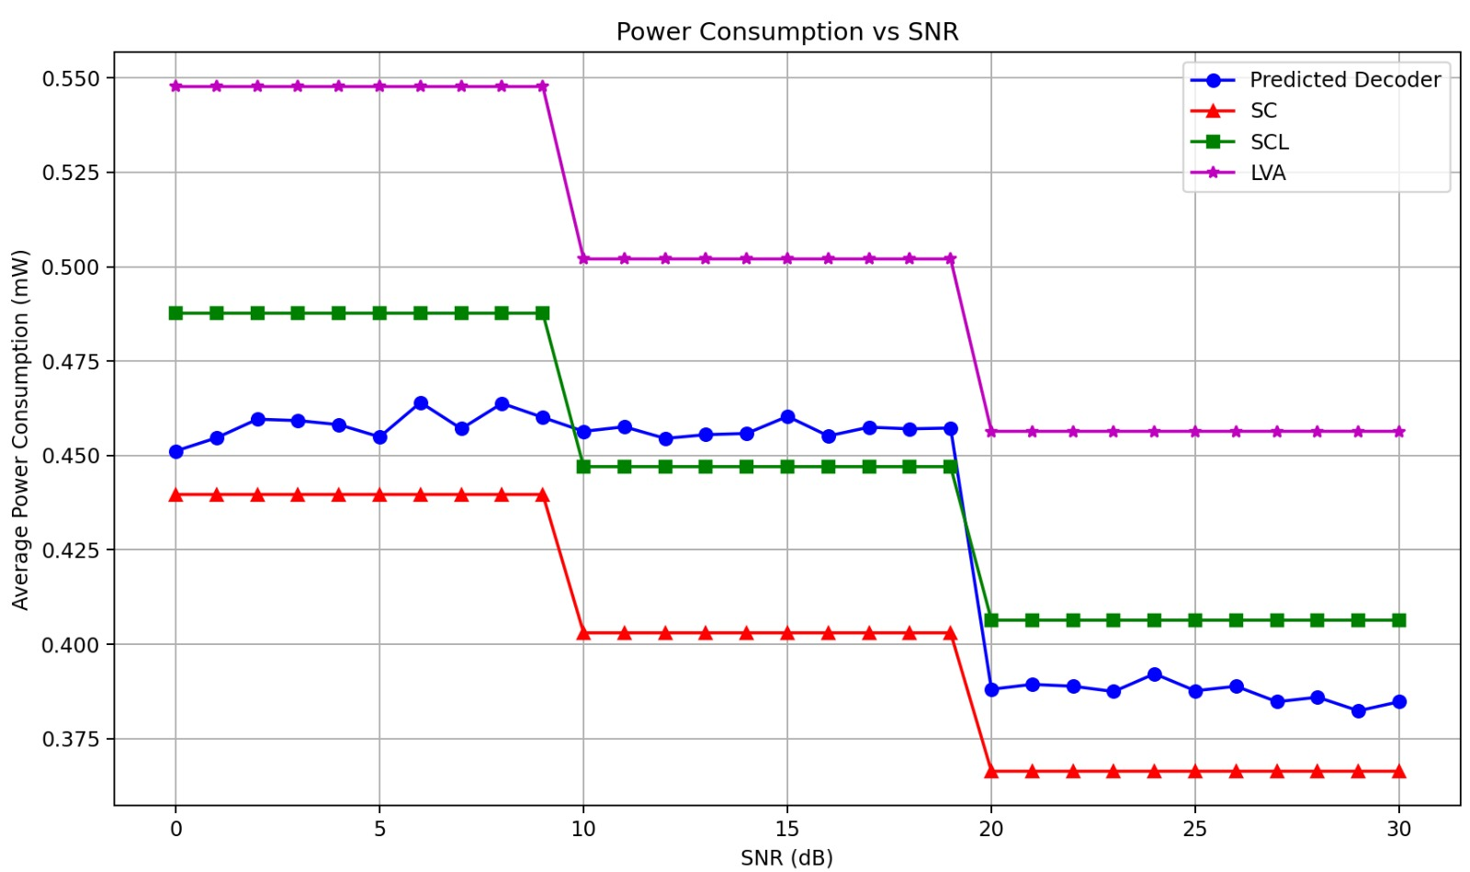
Power Consumption Comparison

Slide 31
LIMITATIONS
Offline Training: The model doesn't adapt after deployment, limiting its ability to handle unforeseen changes in the environment or hardware.
Limited Decoder Pool: Only three decoders (SC, SCL, LVA) are considered, excluding potentially better options like SC-Flip or CRC-Aided SCL.
Simplified Channel Model: The simulation used Rayleigh fading and AWGN, which may not represent real-world interference like multi-node collisions or burst noise.
Memory Constraints on ESP32: Due to limited memory, more complex models (CNNs, RNNs) were excluded.
No Real-Time Re-training: The system cannot adjust to dynamic conditions or evolving environments after deployment.

Slide 32
SUGGESTIONS FOR FUTURE WORK
Real-Time SNR Estimation: Integrate a real-time SNR estimation module (e.g., Kalman filter) for more accurate decision-making by the FNN.
Online Learning & Reinforcement Learning: Implement incremental learning or reinforcement learning to enable the system to adapt continuously and improve performance over time.
Extension to Other Codes: Extend the decoder selection framework to include LDPC and Turbo Codes for broader applicability in different communication standards.
Hardware Optimization: Explore custom hardware acceleration (FPGA/ASIC) and optimize power consumption through event-driven wakeups and efficient sleep modes for ultra-low-power applications.
Adaptive Decoder Pool: Include more advanced decoders and adaptive techniques to improve performance in varied channel conditions.

Slide 33
REFERENCES
X. Liu and C. Huang, "Machine Learning for Polar Codes in Small IoT Devices," Proc. IEEE 7th Int. Conf. Big Data Artif. Intell. (BDAI), 2024, pp. 1–5, doi: 10.1109/BDAI62182.2024.10692447.
L. Huang, H. Zhang, R. Li, Y. Ge, and J. Wang, "AI Coding: Learning to Construct Error Correction Codes," IEEE Trans. Commun., vol. 68, no. 1, pp. 1–12, Jan. 2020, doi: 10.1109/TCOMM.2019.2955119.
K. Almazrouei and K. A. Alnajjar, "Error-correcting Codes in Communication Systems," Proc. 20th Int. Wireless Commun. Mobile Comput. Conf. (IWCMC), 2024, pp. 1–10, doi: 10.1109/IWCMC61514.2024.10592361.
M. Ebada, S. Cammerer, A. Elkelesh, and S. ten Brink, "Deep Learning-based Polar Code Design," Inst. of Telecommunications, Univ. of Stuttgart, Stuttgart, Germany, 2024.
E. Arıkan, "Channel Polarization: A Method for Constructing Capacity-Achieving Codes for Symmetric Binary-Input Memoryless Channels," IEEE Trans. Inf. Theory, vol. 55, no. 7, pp. 3051–3073, Jul. 2009, doi: 10.1109/TIT.2009.2021379.
S. Cammerer, J. Hoydis, and S. ten Brink, "Machine Learning for Communications: Current State and Future Directions," IEEE Commun. Mag., vol. 58, no. 6, pp. 14–19, Jun. 2020, doi: 10.1109/MCOM.001.1900650.
I. Tal and A. Vardy, "List Decoding of Polar Codes," IEEE Trans. Inf. Theory, vol. 57, no. 2, pp. 686–703, Feb. 2011, doi: 10.1109/TIT.2010.2093698.

Slide 34
THANK YOU!

